Slide 1
Satellite Collision Threat Classification
Tamsin Edwards Lambourne, Ryan Liang, Vincent Johnson

Slide 2
Problem Statement

Slide 3
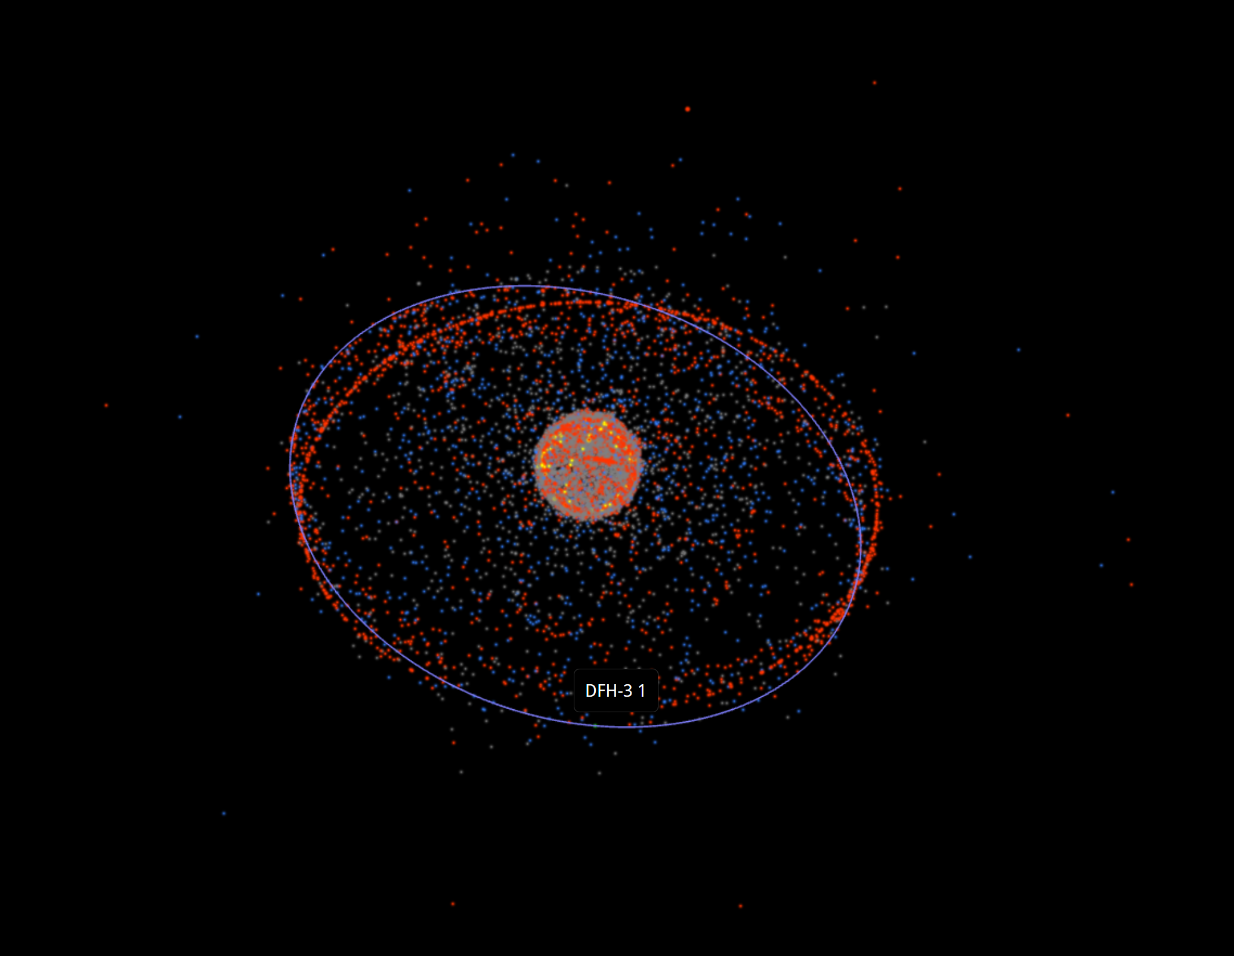
The Problem
Thousands of satellites are in active use orbiting the earth. There are only a few set radii that allow for stable orbits of satellites, so they often end up on extremely similar paths.
This project pulled data from the Union of Concerned Scientists to determine which area pose the greatest risk of collisions for new satellites.
Satellites would be identified using the UCS Satellite Database and can be categorized by their names and features.

Slide 4
The Significance of This Problem
More satellites are constantly launched into orbit and take years or decades before they decay
This leads certain orbits to become overcrowded and increase the problem of space pollution from collisions
Debris from collisions is difficult to track and can cause damage to other satellites or future launches

Slide 5
2. Data Acquisition and Transformation

Slide 6
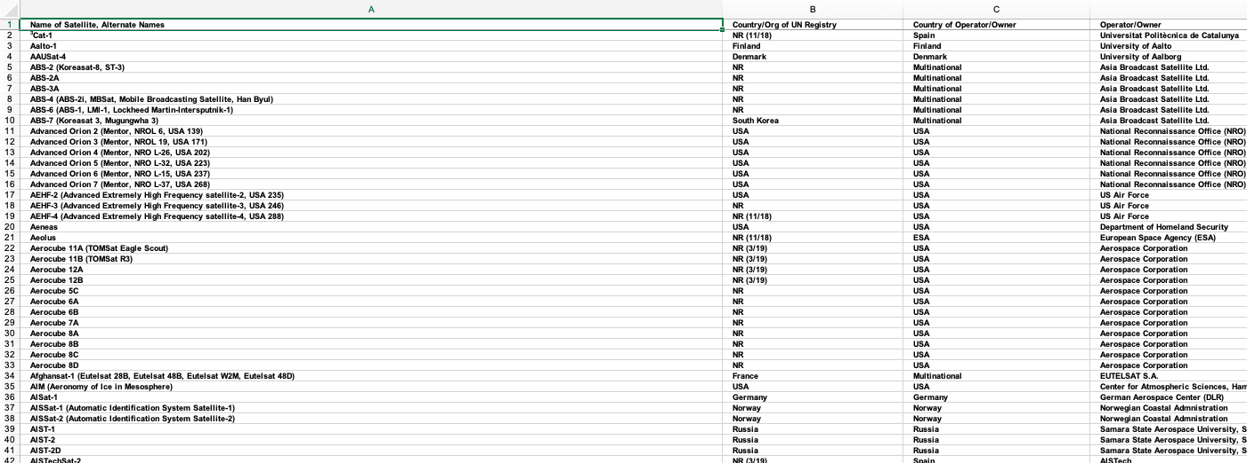
The Dataset
The UCS Satellite Database can be obtained here (https://www.ucsusa.org/resources/satellite-database). This database classifies satellites by their name, user, origin (country), class of orbit, inclination, period (measured in minutes), date of launch, etc. We took the data and cleaned it so we didn’t have any excess or unnecessary data

Slide 7
Data Wrangling and Exploration
We were able to clean the data by choosing or computing the relevant features for our project: average distance from Earth, eccentricity, and inclination.
We constructed a representation of our data by using the matplotlib library pyplot to create subplots and Seaborn library to create scatter plots.
Notes:
Maybe explain what the features mean

Slide 8
Data Prediction
Unsupervised Machine Learning
The machine learning technique that we decided to use was unsupervised machine learning. As a result of using it, we did not have a target variable, just three features (average distance from Earth, eccentricity, and inclination)

Slide 9
3. Results

Slide 10
Model Construction
We constructed two models, a k-Means model and an Agglomerative Clustering model, both with 5 clusters. We wanted to see if there was a big difference between how these models created the clusters.
A min-max scaler was also tested for each of these models and compared to the unscaled models.

Slide 11
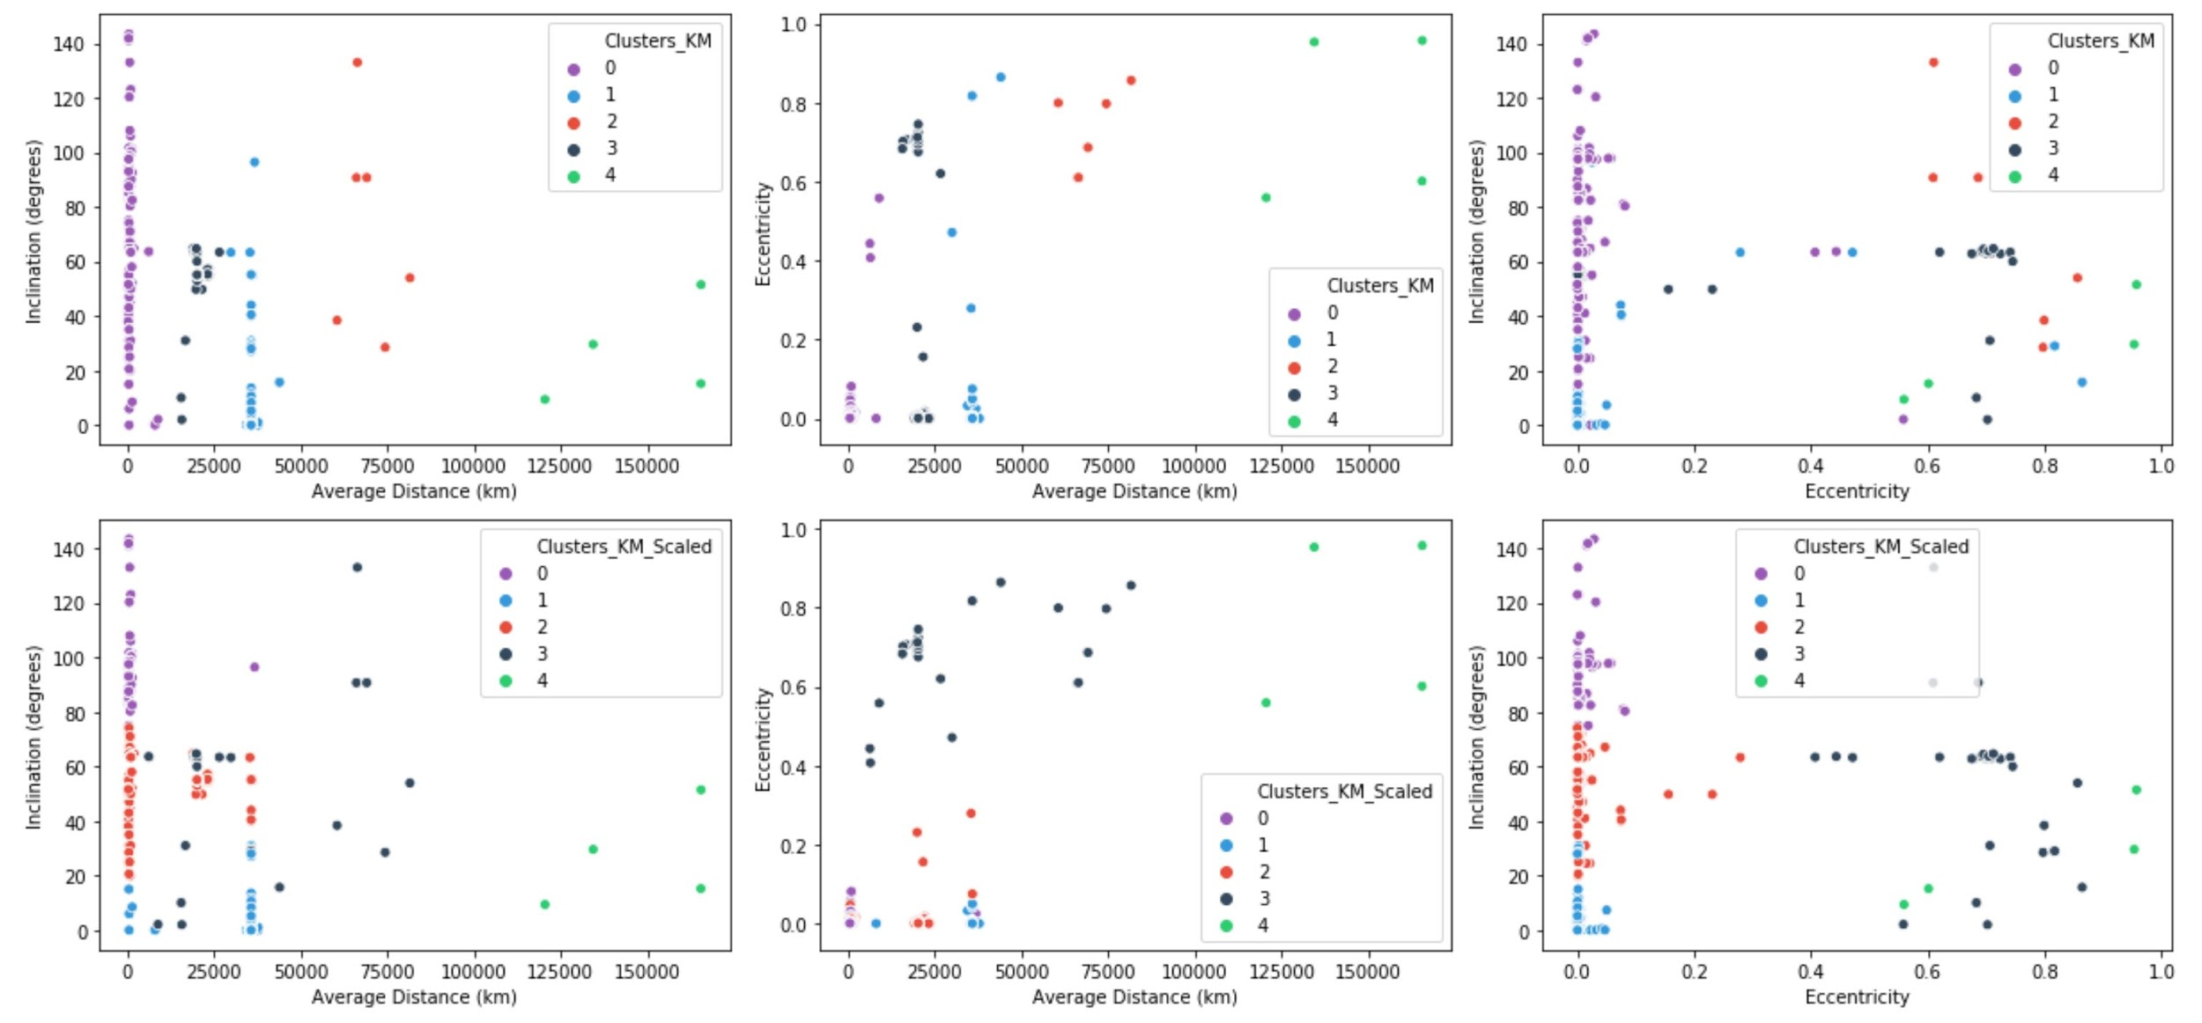
Model Analysis and Evaluation
k-Means clustering results
Notes:
Talk about how unscaled clusters are better, we want clusters to be based on distance more than other features

Slide 12
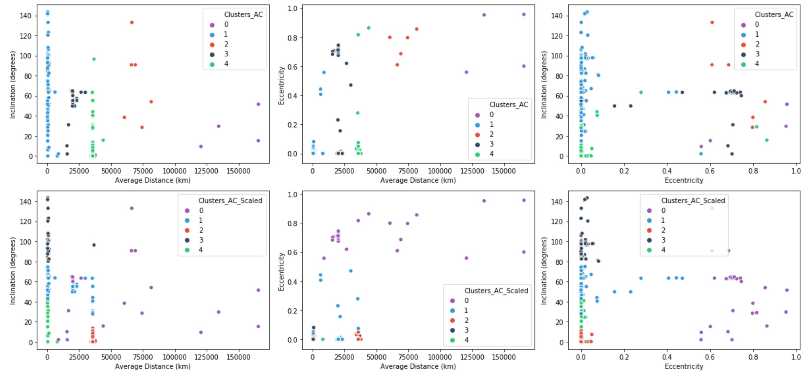
Model Analysis and Evaluation
Agglomerative clustering results
Notes:
Go over this briefly, saying it is very similar to k-means results so we just continued with kmeans

Slide 13
Model Optimization
After choosing the k-Means clustering model, we took the results of the clustering and determined a likelihood ranking for a newly launched satellite to crash into another satellite in the same cluster.
We couldn’t really optimize any parameters in our model because we didn’t / don’t know the target value.
Notes:
Likelihood ranking is relative to its numbers, doesn’t actually give a probability

Slide 14
Discussion

Slide 15
Wrap-Up Discussion
The clusters in question were presented visually on scatter plots which helped compare the results and choose the clustering algorithm of best fit. Both k-Means and agglomerative clustering performed extremely similarly, so we decided to stick with k-Means clustering. We worked with this fitted model and we were then able to rank each cluster according to the crowdedness of the cluster.

Slide 16
Future Model Prediction
We introduced a new satellite launch to our model and used our model to predict the likelihood of the new satellite crashing into other satellites using the k-Means predictor. The prediction that we could make was determining the chance of a satellite hitting another satellite in it’s cluster rather than from another cluster.

Slide 17
Summary
There are thousands of pieces of debris currently orbiting our planet. These include satellites from previous launches, natural debris such as asteroid dust, and particles from collisions. For this project, data on registered satellites orbiting the earth was acquired from the Union of Concerned Scientists. The data was cleaned so that only relevant columns were included in the analysis. The data was put through unsupervised machine learning to classify the satellites into five clusters. These clusters were analyzed to give each one a crowdedness ranking, based on the amount of surface area each satellite in the cluster could take up, to determine the likelihood of satellites crashing into one another within each cluster.

